Slide 1
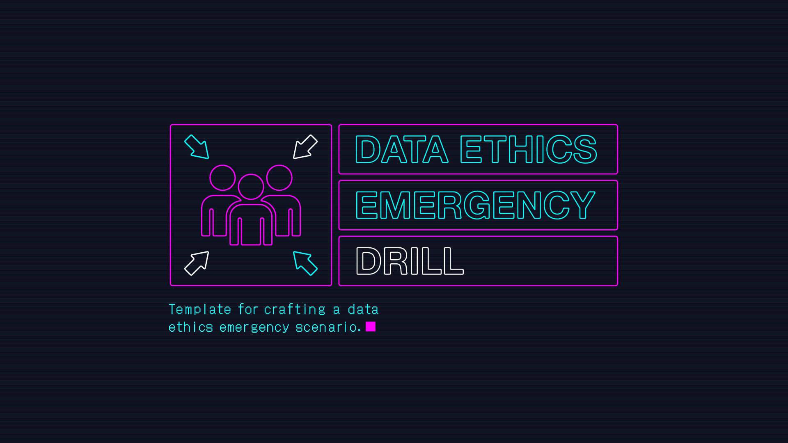

Slide 2
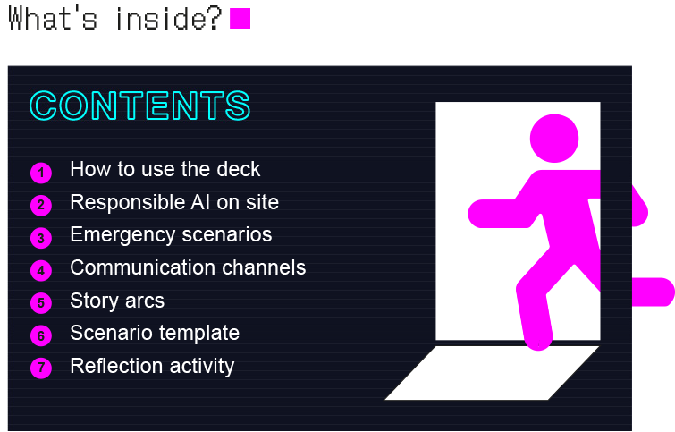

Slide 3
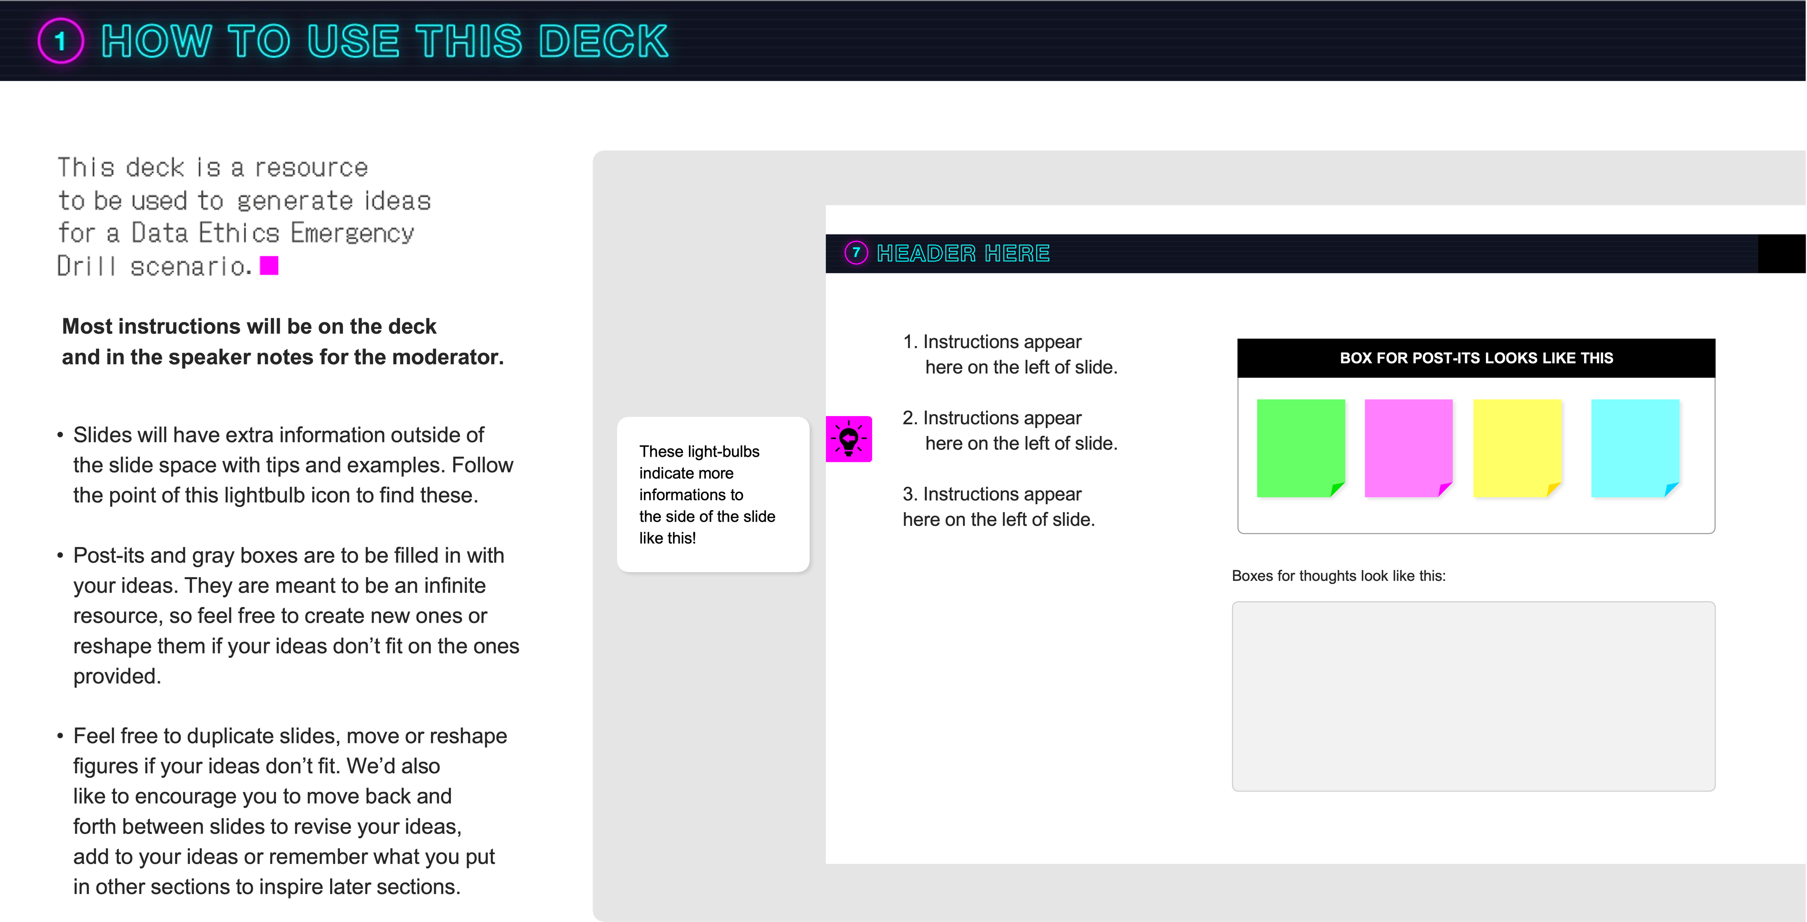

Slide 4
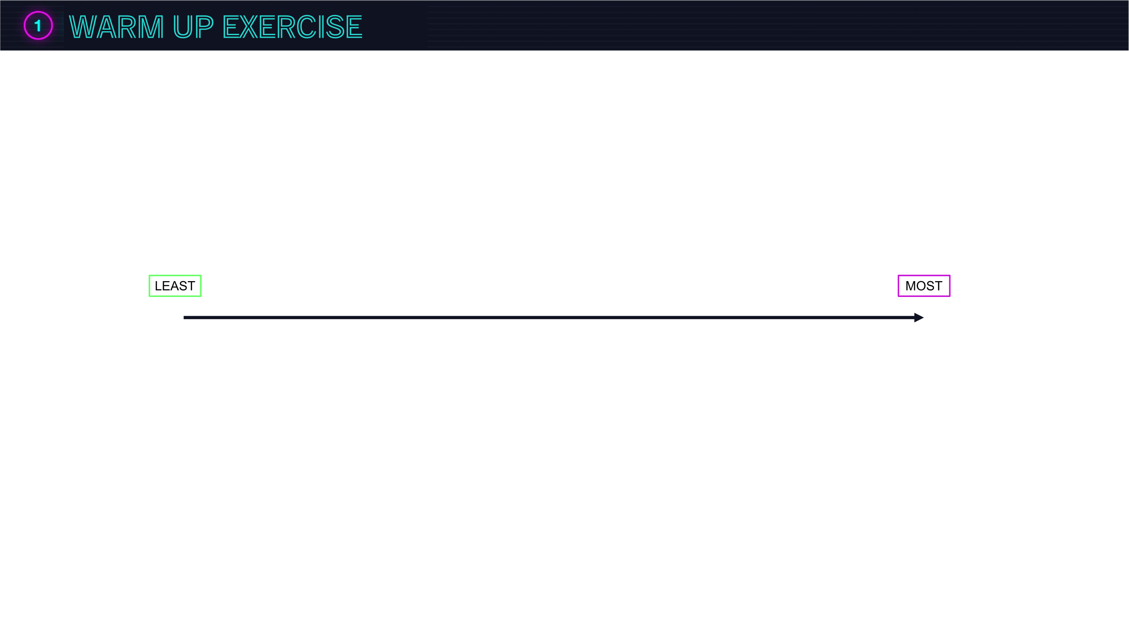
Notes:
RANK THIS from https://www.ideo.com/journal/4-warm-ups-to-prime-your-team-for-decision-making
To begin, have everyone type a noun in each of their stickies. Then have one person propose an adjective and add it to the top of the spectrum. (If your adjective is crunchy, your spectrum would be least crunchy on the left to most crunchy on the right.)
As a group, as fast as you can, collectively sort all the noun stickies along the spectrum of that adjective. (For example, sort all nouns according to where they fall on the scale of least to most hairy, grumpy, or miraculous). Attempting to do it all at once should feel like joyful chaos.
Add a noun to the most empty space of the spectrum
Pick out a new adjective and re-sort, reminding folks that anyone can move any Post-it, not just their own. Go through a few rounds until laughs abound.
Other warm up exercises:
https://lucidspark.com/blog/brainstorming-warm-up-exercises

Slide 5
Sample values behind this square
(uncover if you need inspiration)
Privacy
Fairness
Inculusive-
ness
Dignity
Solidarity
Accoun-
tability
Human autonomy
Sustain-
ability
Trans
parency
Safety
Notes:
This exercise is to establish the current state of responsible AI in the data science team and to get an overview of the maturity of the processes. We expect that this discussion can already inspire some of the potential data ethics emergencies.
Some discussion points:
Are there any values which are not covered by concrete practices? Do any values have intrinsic tensions? Do any of the values clash? Have any of the values clashed? Have any of the practices ever encountered problems? Are there any groups that the processes cannot cater for?
Criteria for picking the top 2-3 values:
They are the most important to you
They are lacking concrete practices
they have practices attached to them that you would like to test

Slide 6
Inspiration
How might current events affect your application?
How could your AI be misconceived by the public
How might marginalized people be affected?
Who does your data/models exclude?
Who does your application work less well for?
What are common criticisms of your technology?
Think of a critical non-expert or expert relative or friend: what might they dislike about your system?
Or browse some AI incident databases here:
https://www.aiaaic.org/aiaaic-repository
https://avidml.org/
https://blogs.gwu.edu/law-eti/ai-litigation-database/
https://incidentdatabase.ai/
https://tech.co/news/list-ai-failures-mistakes-errors
https://github.com/kennethleungty/Failed-ML
Notes:
This is the core of the scenario. The idea is to generate a good amount of possible scenarios to give you flexibility on what can be realised as prompts in the drill. Each colour represents the scale of impact on your business. The axes represent how likely you expect this scenario to be and how difficult you think it will be to solve. The colour of the post it describes the impact that it would have on the business.
Generating versions of different magnitudes of difficulty, likeliness and impact can help create an overarching narrative when making the prompts into a coherent scenario drill.
If you are stuck for ideas try taking a look at the inspiration box.

Slide 7
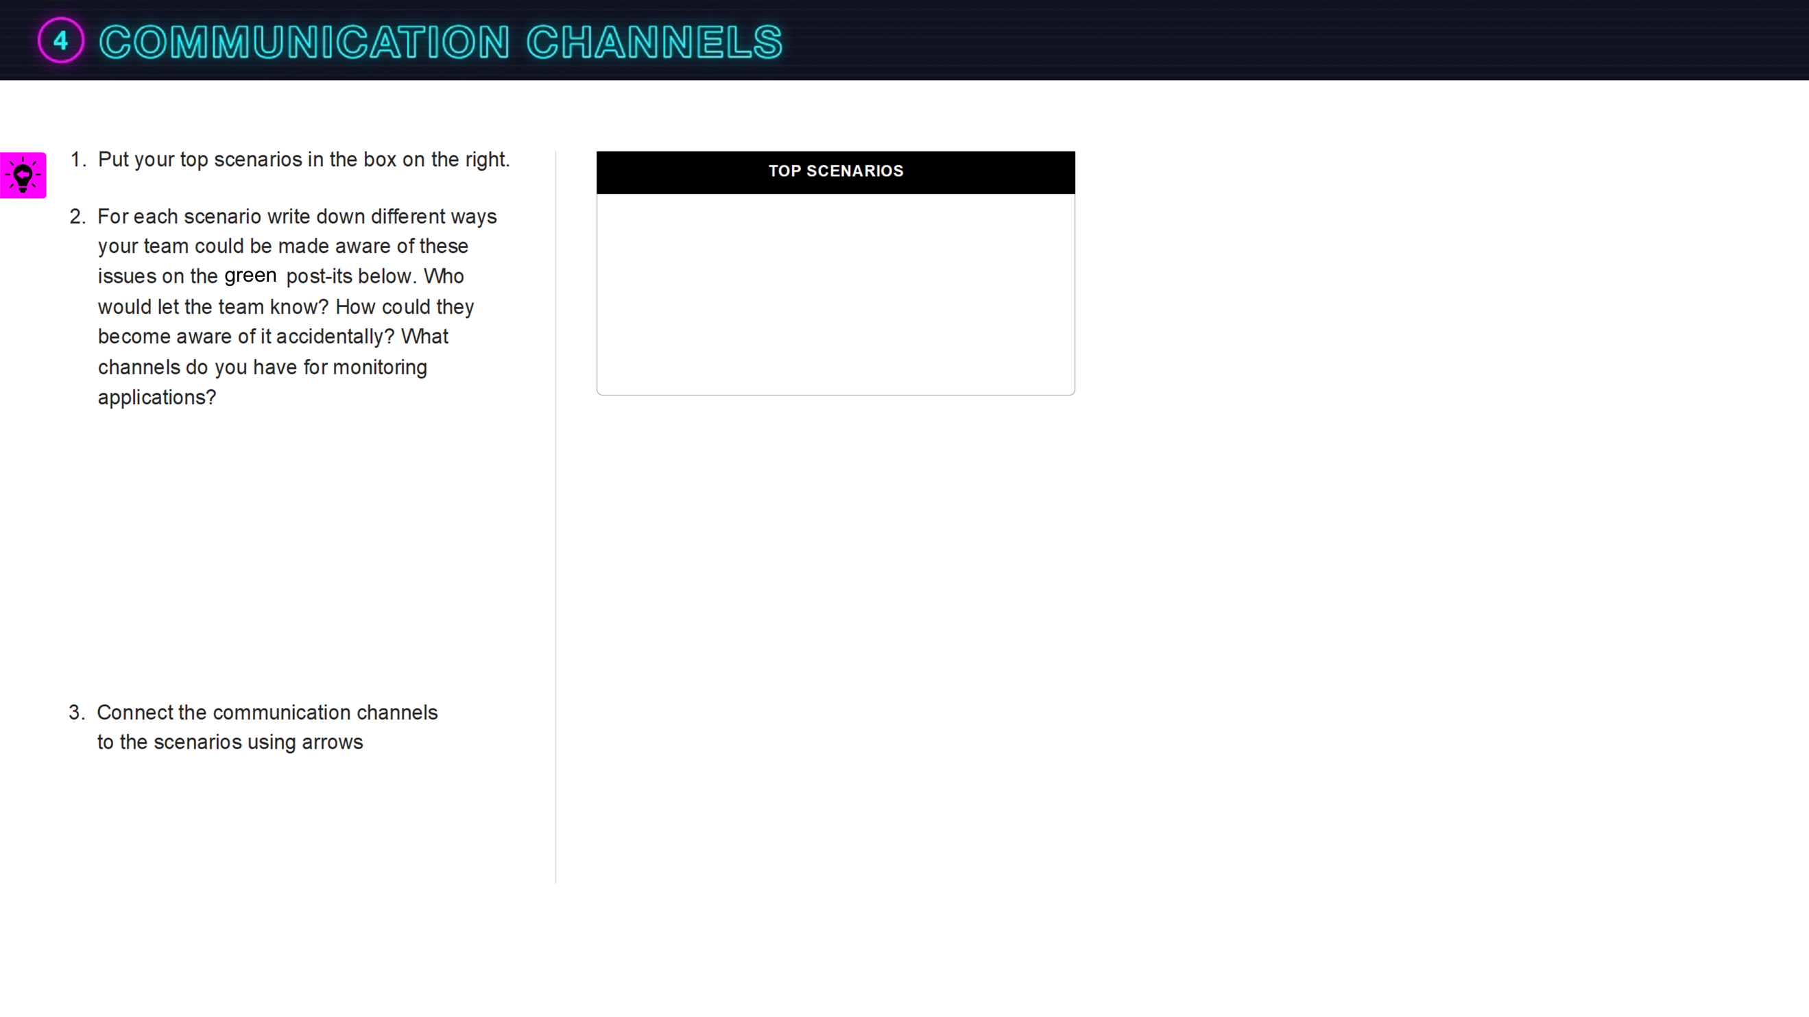

Samples behind this square
(uncover if you need inspiration)
Team Lead
CEO
PR Team
Internal Socials (Slack, teams,…)
External Social Media (X, LinkedIn,…)
News
Customer Service
Model Monitoring Team
Internal Newsletter
Whistle-
blower
System Pop Up
Perfor-
mance degradation in A/B Testing
Scheduled System health Review
Negative App Store or Marketplace Reviews
Spike in API Requests or Traffic
Automated Error Notification
Notes:
This exercise directly serves structuring the scenario and designing the discussion prompts, by collecting information on how these could look like.
Further discussion points: who are the main informants? What is their relationship to the team and have they been messengers of issues before? Are the news sources outside or inside of the team? Can you invite any of these stakeholders to participate?

Slide 8
Notes:
This is where you start to build your drill. Think of your drill as a series of events that gradually evolves, where your participants receive more information about a situation as they go along. One way to build this drill is to make the situation worse with every event. You can make use of the graph in Exercise 2 where you generated variations of the same situation to help you find different events that could fit into the same theme.
If you are a group of scenario crafters, split the different ideas among yourselves to elaborate individually for a 10-15 minutes and then come back and share the story arcs . The next slide is a template to add this detail individually.
1st Event: Light introduction to the problem – find an event that could introduce the participants to the problem for example by giving it a context of a previously discussed issue,
2nd Event: Understand and elaborate the details of the problem – find an event that makes clear what actions participants have to take to solve the problem and pushes them to look at the details
3rd Event: Final Escalation/Summary of the problem – find an event that allows participants to summarize their stance e.g. a presentation to other members or reacting to the public

Slide 9
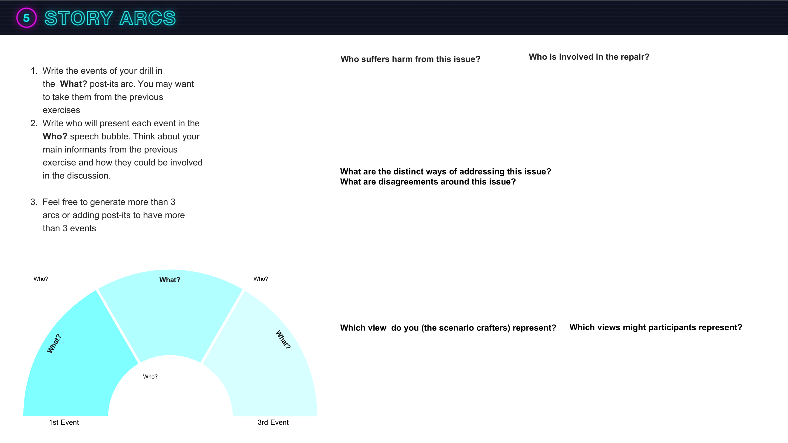
2nd Event
Notes:
This is a slide where you can focus on elaborating a story arc. Copy and paste this slide according to the number of ideas you have. You may want to skip this task if you are working alone.

Slide 10
2nd Event
Notes:
This is a slide where you can focus on elaborating a story arc. Copy and paste this slide according to the number of ideas you have. You may want to skip this task if you are working alone.

Slide 11
2nd Event
Notes:
This is a slide where you can focus on elaborating a story arc. Copy and paste this slide according to the number of ideas you have. You may want to skip this task if you are working alone.

Slide 12
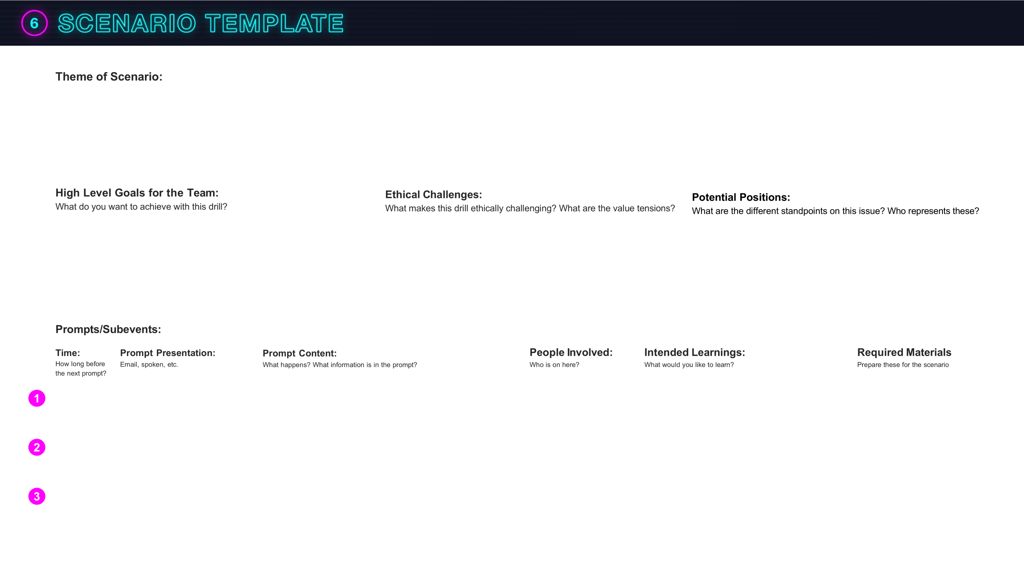
Notes:
This is where you flesh out the details of your scenario. You might still want to try creating several different scenarios to then decide which one works best and where you can convince key stakeholders to participate. Feel free to fill out each box in an order that suits you.
Discussion points: Do the prompts form a coherent scenario? Is there enough material or too much material to discuss? How do you best involve the presenters of each prompt? Does each prompt present enough new information to stimulate a discussion? Can you give participants a concrete task to solve to focus the discussion? Who can you invite to ensure a diversity of opinions?

Slide 13
Notes:
This reflection activity can serve three purposes
It gives the moderator a collection of insights from each participant of the drill
It gives a chance for less vocal participants to put down their thoughts
It offers a learning opportunity for participants to consolidate their experience of the drill

Slide 14
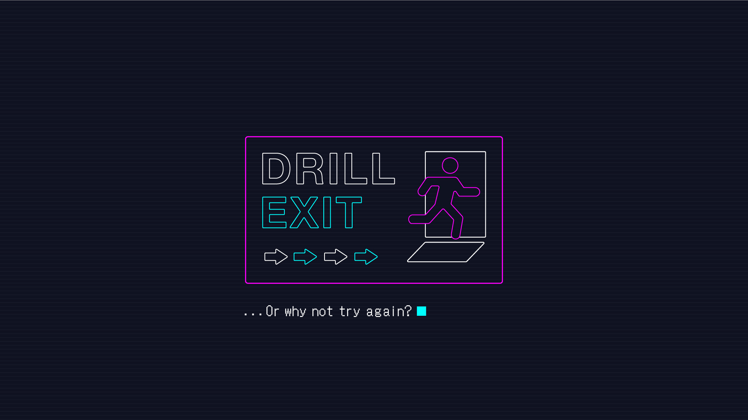
Notes:
Now find participants to test the drill!

